Slide 1

US Housing Prices Machine Learning Model
Team Outliers

Slide 2




Team Outliers
Matt Hardy
Ruchi Mathur
Kathy Nwe
Paula Thompson
Notes:
Hi Everyone
My name is Paula Thompson and I will be introducing Team Outliers
Made up of Matt, Ruchi, Kathy and myself

Slide 3
Project Focus
Create a machine learning model to predict housing prices across various regions based on inflation rates, unemployment rates, gas prices, interest rates and average mortgages
40-year high in inflation rates
Interested in understanding the impact these aggressive increases will have on housing prices across our various locations.
Can we predict housing prices based on the above variables across different regions in the United States?
Question
Notes:
Our project was focused on creating a machine learning model that predicts housing prices in the United States based on a number of variables including inflation rates, unemployment, rates, gas prices, interest rates and mortgages

Slide 4
Project Flow Chart
Datasets (CSVs, Labeled):
Consumer Price Index
Housing Prices
Mortgage Rates
Gas Prices
Unemployment Rates
Data Transformation:
Dropping null values
Filtering dates
Dropped unnecessary columns
Transposed data
Set date as index, region id as column headers
Converted date to uniform date-time
Assigned zips and coordinates to locations
Database:
Postgres
Compiled CSV
Machine Learning Model:
Multiple Linear Regression Model
Random Forest Regressor
Neural Network Model
Model Evaluation:
MAE
MSE
RMSE
R2/ Adjusted R2
Notes:
Here you can see ahigh level summary of the various stages of our project
We are going to be covering each of these stages in more detail during our presentation

Slide 5
Technologies, Languages, Tools, Etc.
Data Preprocessing
Database
Machine Learning
Dashboard
Python
Pandas
Uzaipcode
Geopy
Nominatim API
Pathlib/Path
Jupyter Notebook
SQL
PostgreSQL
Excel
Python
pandas
numpy
matplotlib
sci-kit learn
Seaborn
tensorflow
Jupyter Notebook
Tableau
VizQL
Tkinter (Python)
Notes:
The team used a variety of technologies, languages and libraries during the different stages of our project and you can see a comprehensive list of them here
We wont go into detail on all the tools we used but as we walk through the project you will hear more detail on how some of these tools were used

Slide 6
Data Exploration
Zillow Housing Price Dataset
Consumer Price Dataset
Gas Prices
Mortgage Payment Data
Unemployment Rates
Interest Rates
Notes:
We also pulled data from a variety of sources, including Kaggle as well as a number of government data sources, which we ultimately consolidated into our primary dataset
With that I will hand it off to Matt to talk more about data transformation and pre-processing performed on that primary dataset.

Slide 7
Data Transformation and Preprocessing
Pandas and Excel were used for data preprocessing
The preprocessing steps taken include:
Dropping Null Values
Limiting the date based on availability across various data sources
Transposed data
Set date as index, region id as column headers
Converted date to uniform date-time
Assigned zips and coordinates to locations
Notes:
Hello everyone, I'm Matt Hardy, and I'll be talking about the data tranformation process our team used to make our data useful
for our machine learning model, as well as the Geocoding API we used in order to visualize the data on a map.
screenshot of original dataset:
This is our original dataset of housing prices from different areas over the years, which we obtained form Zillow. It covers
3,728 cities within the US, and ranges from early 2008 all the way to the current month.
Right away you can see there's some null values here. That's because while all the rows contain SOME data, not all the data begins
in 2008. We had to shorten our range of years to being in 2001 because if we elimanated all rows with null values from the
original, unchanged dataset, we were left with only around 500 cities. Our new range allowed us to used almost 1100.
notebook 1, transposed framework:
The next problem we faced was the way our data was shaped. The original dataset was using unique "Region ID's" as an index, the
first few columns to show a city and state, and then more than a hundred columns representing dates. Each of our other data sets
used the date as the index, and so we needed to transpose the data so that each city's Region ID was a column header. In our
early data cleaning, we built a framework for how the data would be transposed once it had gone through the geocoding engine.
notebook 2, duplicates cell:
The region ID was used rather than the city name, because some quick coding revealed that we had more than 100 cities with
identically named counterparts in other states.
notebook 2, zipcodes engine:
Our next issue was that apart from city and state name, no specific geographic information was included in our dataset to facilitate
visualization of the data on a map. After much experimenting, we decided to use the USZIPCODE python library to pair each location
with a zipcode. Many (in fact, most) locations returned more than one zipcode, so we instructed our code to only keep the first
zipcode returned. The library was unable to locate some locations, and so after we processed the zip codes (and eventually
coordinates) we would use python merges to act as SQL inner joins to keep only the locations for which we had complete data.
We also added the cities for which location data couldn't be found to a separate dictionary/dataframe so that we could see exactly
how much data we were purging from our dataset. We later noticed some duplicate zipcodes in our final dataset (it seems that some
suburbs share zip codes without sharing names), and so the code was refactored to exclude duplicates before being pushed back through
the geocoding engine.
notebook 3, geocoding:
once we had our list of cities matched with zipcodes, we used the GeoPy python library to launch an API call to Nominatim, a
geocoding service. Once again,
our engine didn't find results for every last location, and so our dataset was again slightly reduced.
ERD Diagram:
Our cleaned, non-transposed dataset was fed into a PostgreSQL database alongside our various other datasets and our newly populated
geolocation dictionary. Though we could have joined the data into our final dataset using SQL inner joins, we decided to use
python exclusively to do this since it would make the transposition process a bit faster and easier.
notebook 5:
The first thing we needed to do before transposing our data was to purge all locations from our original dataset that didn't appear
in our locations database, which ultimately brought us from 1097 cities down to around 938. This number might change each time
the etl scripts are run, since the API call may locate more or fewer coordinates each time. Once the data had been tranposed,
with the Zip Codes (rather than region ID's) as column headers, each of our other datasets (inflation, mortgage rates, unemployment
rates, interest rates, and gas price data) were loaded, cleaned, and then merged as an inner join to the main dataframe. In most
cases, the only cleaning that needed to take place was to change the date (the index for each source) to a uniform date-time format.
At this point, the data was ready to be used in our machine learning model, but we ran into trouble visualizing it in tableau because
of its extremely wide shape. In the end, we used the Pandas ".melt()" method to create a looooooooong skinny form of our dataset
which was only 8 columns wide, but 104,118 rows long. This version of the data was finally something we could use with tableau.
extracted:
Our first dataset, obtained from Zillow, contained chronologically formatted housing price data from 3,728 cities in the US,
spanning a timeframe between early 2008 all the way to the current month. We initially had thought that pairing this massive data
source with our second dataset, a record of the national Consumer Price Index (all the way back to 1913) would be enough to produce
our model, but as our project evolved we decided to incorporate other datasets that we felt could improve the accuracy of our
algorithm.
Very quickly we realized that there was a problem with our dataset. As you can see in this screenshot, there are many empty cells
in some of these rows. That's because while each row does contain SOME data, the data for each location didn't necessarily begin
in 2008. The first time I tasked Pandas with dropping all rows that contained null values, we lost all but around 500 cities,
hemorraging some of the largest cities in the process. We decided to narrow the scope of the time-frame in our datasource, and
after playing around with a few different starting years, we landed on 2011 because at that point dropping all null values still
left us with almost 1100 cities, which we felt was enough data points to proceed.

Slide 8
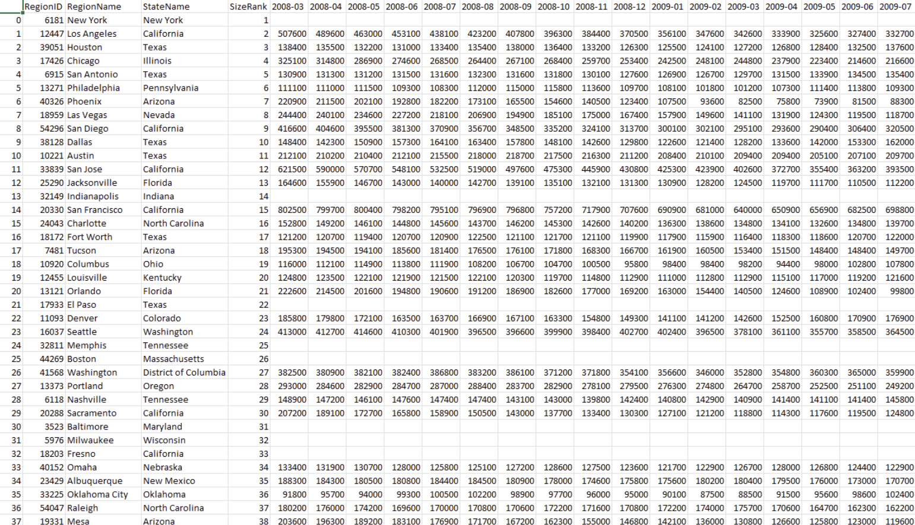
Data Transformation and Preprocessing
Notes:
Matt to share screen after this slide

Slide 9
Machine Learning
Tested three machine learning (ML) models:
Multiple Linear Regression (model of choice)
Random Forest Regressor
Neural Network Model
Notes:
As mentioned before during our presentation, our problem statement and the question that we are asking is:
Can we predict housing prices based on the economic factors like inflation rate in the form of CPI index, average gas prices, unemployment rates, average mortgage rates, and interest rates across different regions in the United States?
So, to find an answer we tried different machine learning models:
multiple linear regression model,
random forest regressor , and
neural network model.

Slide 10
ML: Data Preprocessing
Import dependencies
Import dataset
Check for any missing values
No encoding needed
Split the data into testing and training sets
Feature Scaling
Notes:
In addition to the transformation and preprocessing done before, we followed additional pre-processing steps prior to implementing a machine learning model.
First, We imported all the dependencies needed for the models.
Then final dataset was imported by reading in the csv file.
We checked for any missing values one more time.
Since all of our data is numerical we did not need to go through any encoding.
Then, the data was split into testing and training sets and feature scaling was performed. For feature scaling, we decided that the variations in our dataset can be minimized by dividing the housing prices by 1000.

Slide 11
ML: Multiple Linear Regression
Linear relationship between a single dependent continuous variable and more than one independent variables
All variables are quantitative
Dependent variable
Housing Prices
Independent variables
Gas Prices
Unemployment Rate
Average Mortgage Rate
Interest Rate
CPI (Inflation Indicator)
Notes:
A linear regression model is an appropriate choice for making numerical predictions, especially when there is linear relation between the features. In our case, since we have multiple features in our dataset, a multiple linear regression model is applicable.
The Multiple linear regression algorithm, models the linear relationship between a single dependent continuous variable and more than one independent variables.

Slide 12
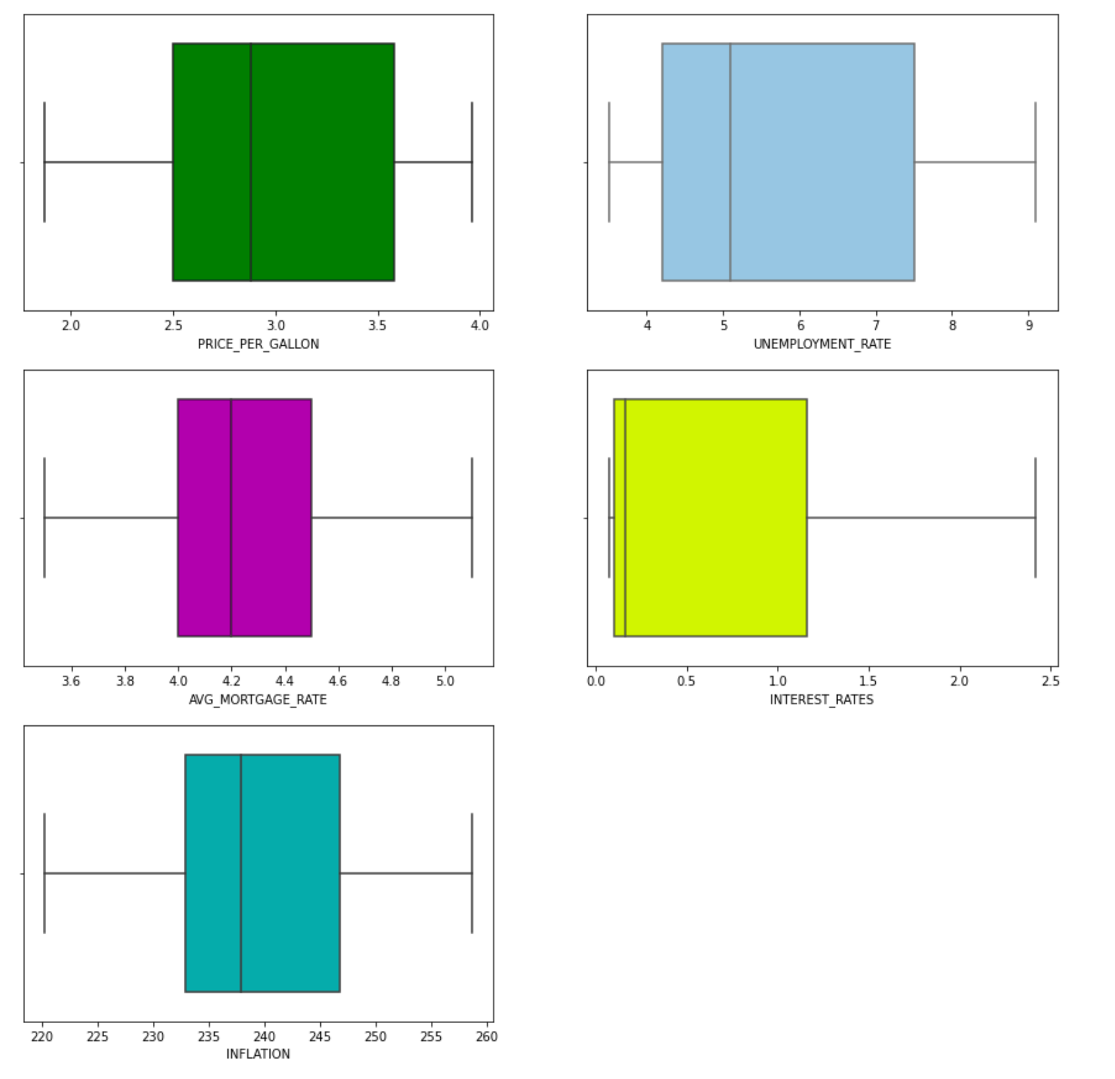
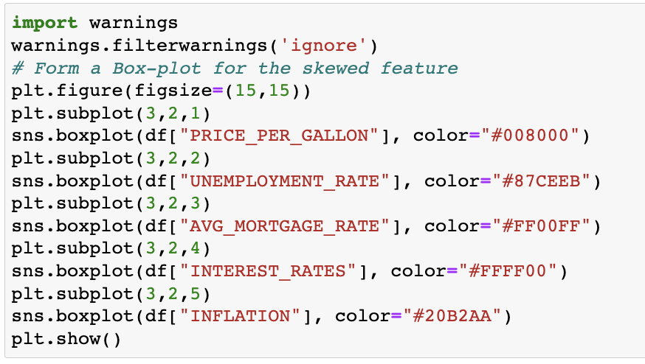
Multiple Linear Regression
Outlier Detection
Boxplot illustrated that there were no outliers in the datasets
Notes:
Presence of outliers in a dataset can result in a poor fit and lower predictive modeling performance. So we utilized boxplots to identify any outliers in our dataset.
As illustrated in this image, we did not find any outliers in this case.
*** However, I just want to bring it to attention that Identifying and removing outliers is challenging with simple statistical methods for most machine learning datasets given the large number of input variables. Instead, automatic outlier detection methods can be used in the modeling pipeline and compared, just like other data preparation transforms that may be applied to the dataset. The scikit library has several options for automatic outlier detection, an example is Isolation Forest, or iForest for short.

Slide 13
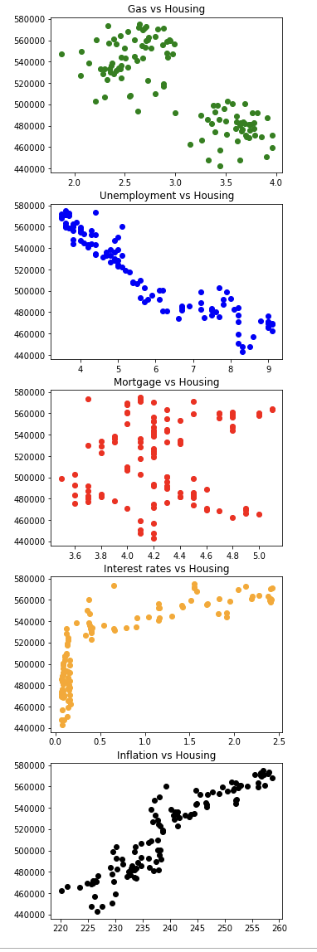
ML: Multiple Linear Regression Feature Engineering and Selection
Feature Engineering –
Finding missing values and removing from dataset
Replacing Region IDs with Zip codes
Feature Selection-
Preparing scatter plots to check linearity
Dropped Mortgage Rates
Notes:
Our Feature engineering involved
Handling missing values and Replacing region IDs with Zip codes. This was detailed during the data transformation part of our presentation.
For Feature selection: We created scatter plots for each feature. Based on the these scatter plots, we can see that Interest Rates and Inflation (Consumer Price Index - CPI) have a linear relationship with Housing Prices. The Gas Prices and Unemployment Rates also have a linear relationship with Housing Prices, but with a negative slope, which means that housing prices decrease with increasing gas prices and unemployment rates. We can also see that Mortgage rates do not have a linear relationship with Housing Prices. So, in order to move forward with MLR model, we decided to drop Mortgage Rates feature from our dataset.

Slide 14
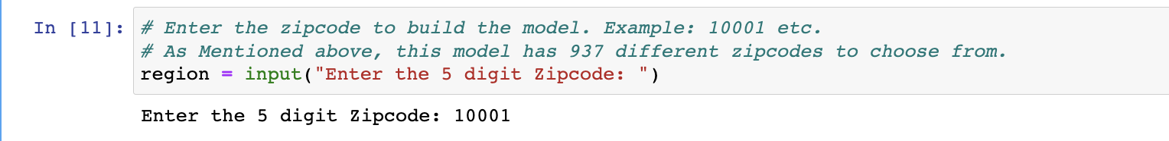
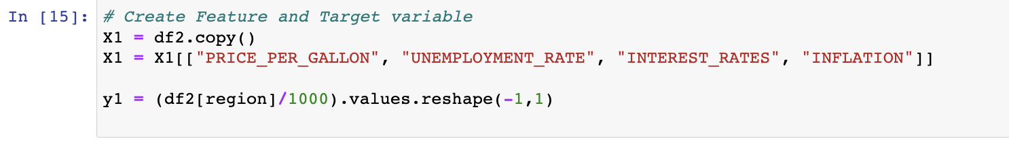
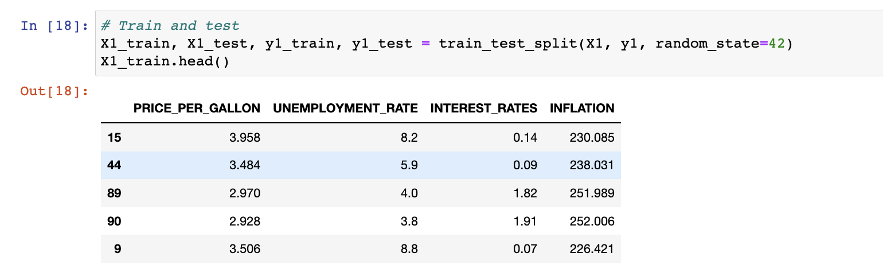
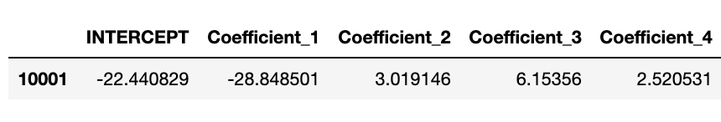
ML: Multiple Linear Regression Modeling Process
Select Zip Code
Create Feature & Target Variables
Split into Training and Testing Sets
Linear Regression Model
Model Training
Prediction
Notes:
This slide here summarizes the machine learning modeling process for multiple linear regression model. We begin by selecting the zip code that we are interested in for predicting housing prices. This pulls in the housing prices data for that particular zip code. Then we create feature and target variables. We split the data into training and testing sets. We apply the linear regression model, we train the model and finally make predictions based on the model.

Slide 15
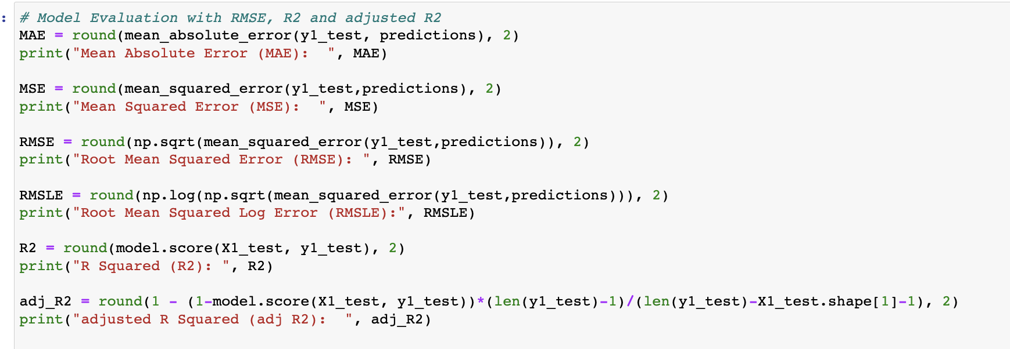
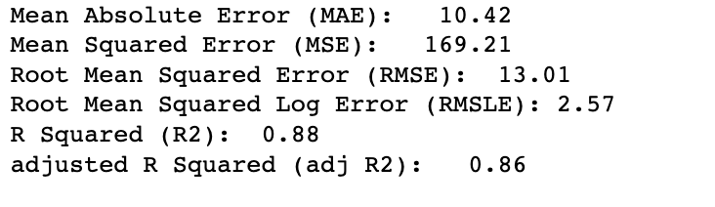
ML: Multiple Linear Regression Model Evaluation
Mean Absolute Error (MAE)
Mean Squared Error (MSE)
Root Mean Squared Error (RMSE)
Root Mean Squared Log Error (RMSLE)
R Squared (R2)
Adjusted R Squared (Adj R2)
Notes:
To evaluate model performance we calculate several parameters.
R2 is the Coefficient of Determination or Goodness of fit. It calculates how must regression line is better than a mean line.
***(The disadvantage of the R2 score is while adding new features in data the R2 score starts increasing or remains constant but it never decreases because It assumes that while adding more data, variance of data increases. But the problem is when we add an irrelevant feature in the dataset then at that time R2 sometimes starts increasing which is incorrect.
To control this situation we use adjusted R2.)
Since we have multiple features in our dataset, we also want to calculate adjusted R2.
As we can se in this example that adjusted R2 is slightly lower than R2.
----------------------------------------------
MAE is a very simple metric which calculates the absolute difference between actual and predicted values.
MSE represents the squared distance between actual and predicted values. we perform squared to avoid the cancellation of negative terms and it is the benefit of MSE
RMSE The metric is very helpful when you are developing a model without calling the inputs. In that case, the output will vary on a large scale.
To control this situation of RMSE we take the log of calculated RMSE error

Slide 16
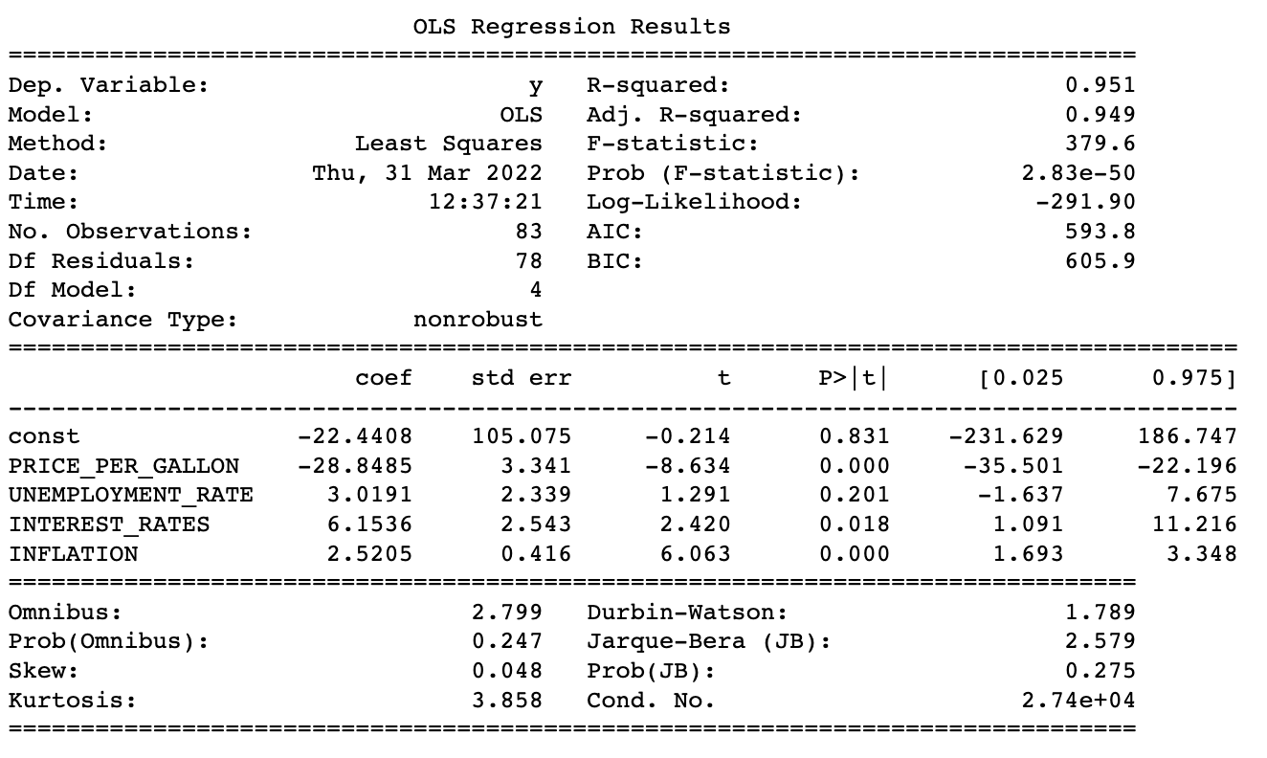
ML: Multiple Linear Regression Model Evaluation
Using statsmodel Python library (OLS function)
Notes:
Statsmodels is a Python library built specifically for statistics. We wanted to have all model statistics in one place in tabular format so we used OLS from statsmodel.
(OLS) or Ordinary Least Squares regression is a common technique for estimating coefficients of linear regression equations **** which describe the relationship between one or more independent quantitative variables and a dependent variable
Notice that the coefficients captured in this table match with the coefficients generated by sklearn (shown in previous slides).

Slide 17
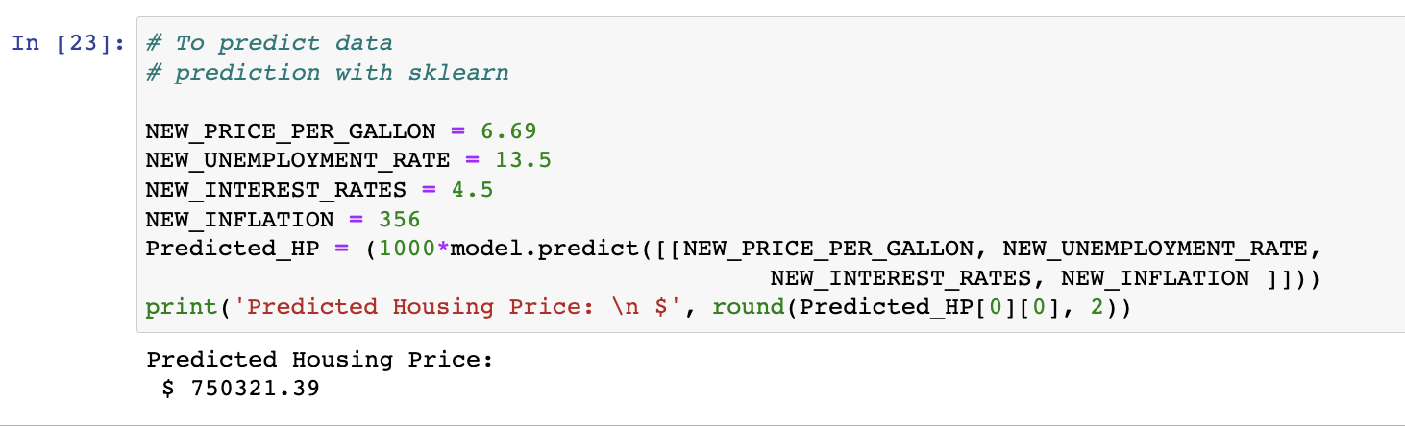
ML: Multiple Linear Regression Model Evaluation
Providing desired inputs for features and predicting housing prices in zip code 10001
Notes:
Now lets say my question is, what would be the housing price in zip code 10001 (which is in NY btw) when average gas price hits $6.69, unemployment rate hits 13.5, interest rates are at 4.5, and the Consumer price index is at 356 points. These inputs are outside of our current dataset feature value range, as in these are more than the maximums in the dataset.
I can use this model which will predict the housing price to be at $750,321.

Slide 18
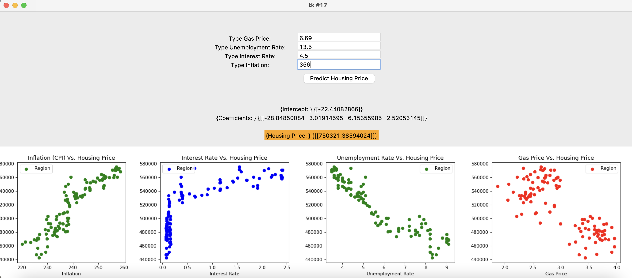
ML: Multiple Linear Regression Graphic User Interface (GUI)
GUI to allow user to input
Tkinter Python library
Notes:
We also created a Graphic User Interface to visualize the model predictions in a pop up window. This GUI will allow users to input the desired economic factors in order to get predicted housing prices.
We did this by using Tkinter, which is a standard GUI library for Python.
*** (Python when combined with Tkinter provides a fast and easy way to create GUI applications.)
Once we run the code, we will see this GUI, which includes the output generated by sklearn and the scatter diagrams for the selected Zip code. To bring to your attention that this is the same prediction we saw in the previous slide by using model.predict command.
The live version of this GUI will be presented later during the dashboards and visualization section of this presentation.

Slide 19
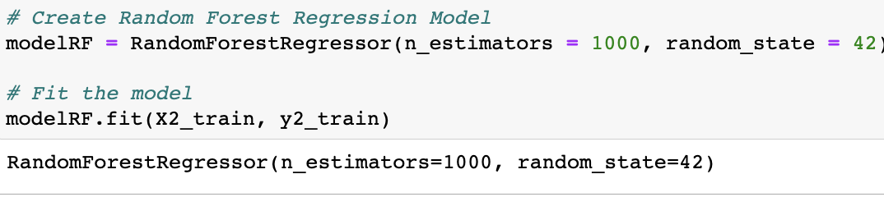
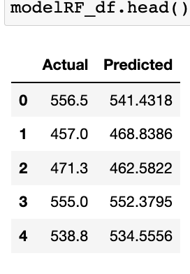
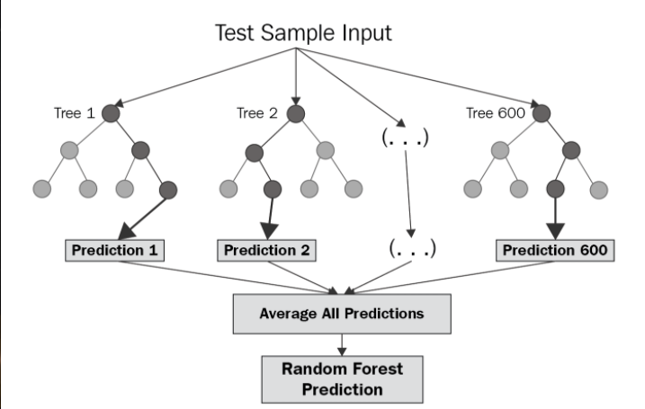
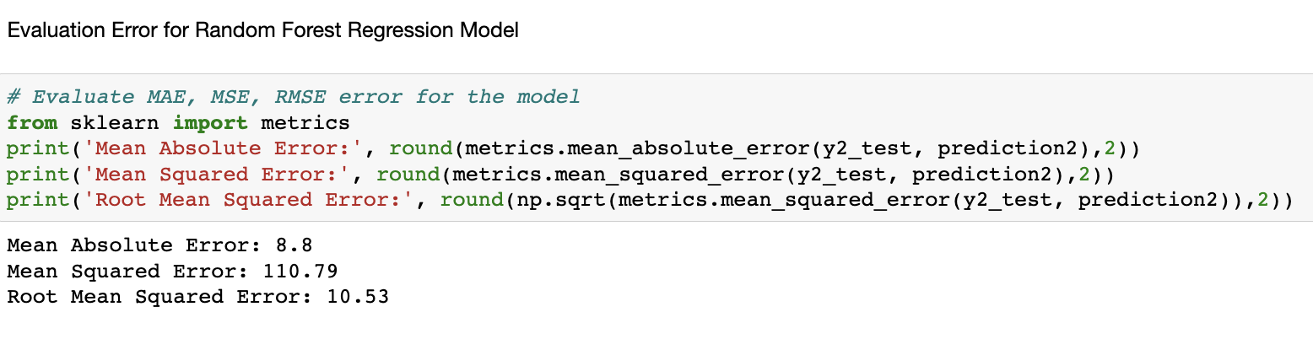
ML: Random Forest Regressor
Notes:
Now we would like to talk a little bit about the other machine learning models we considered to solve our problem of housing price prediction.
Random forest is a type of supervised learning algorithm that uses ensemble methods (bagging) to solve both regression and classification problems. The algorithm operates by constructing a multitude of decision trees at training time and outputting the mean or mode of prediction of the individual trees.
When we apply RandomForest Regressor model with a thousand estimators and train the model, the trained model shows a comparison of actual and predicted values, which are quite close as you can see. Then we also ran model evaluation to give us model performance metrics.

Slide 20
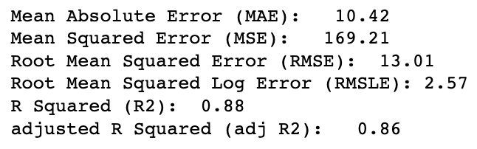
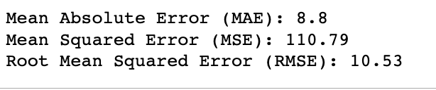
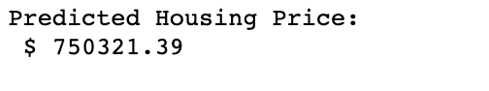
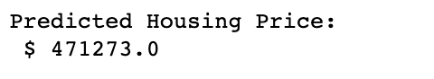
ML: Comparison– Multiple Linear Regression Vs. Random Forest Regression
Multiple Linear Regression | Random Forest
Evaluation Metrics:
Predictions with similar inputs:
Random Forest is Better?
Why we can’t use this model?
Decision trees, less chance of overfitting
Greater Accuracy
Cannot Extrapolate
Notes:
Here we have a comparison of the Multiple linear regression model and Random Forest Regressor. When we compare the evaluation metrics of the two models, it appears that the Random Forest performs better. But when we want to predict with the same input parameters for both models we see that the predictions are very different! The reason is that a random forest regressor can not extrapolate and will always make predictions less that the maximum value of the available dataset that it has trained on.
So, to summarize, a random forest model is better because decision trees have less chance of overfitting and can provide greater accuracy.
However, this cannot be our model of choice for this specific problem because it cannot extrapolate.

Slide 21
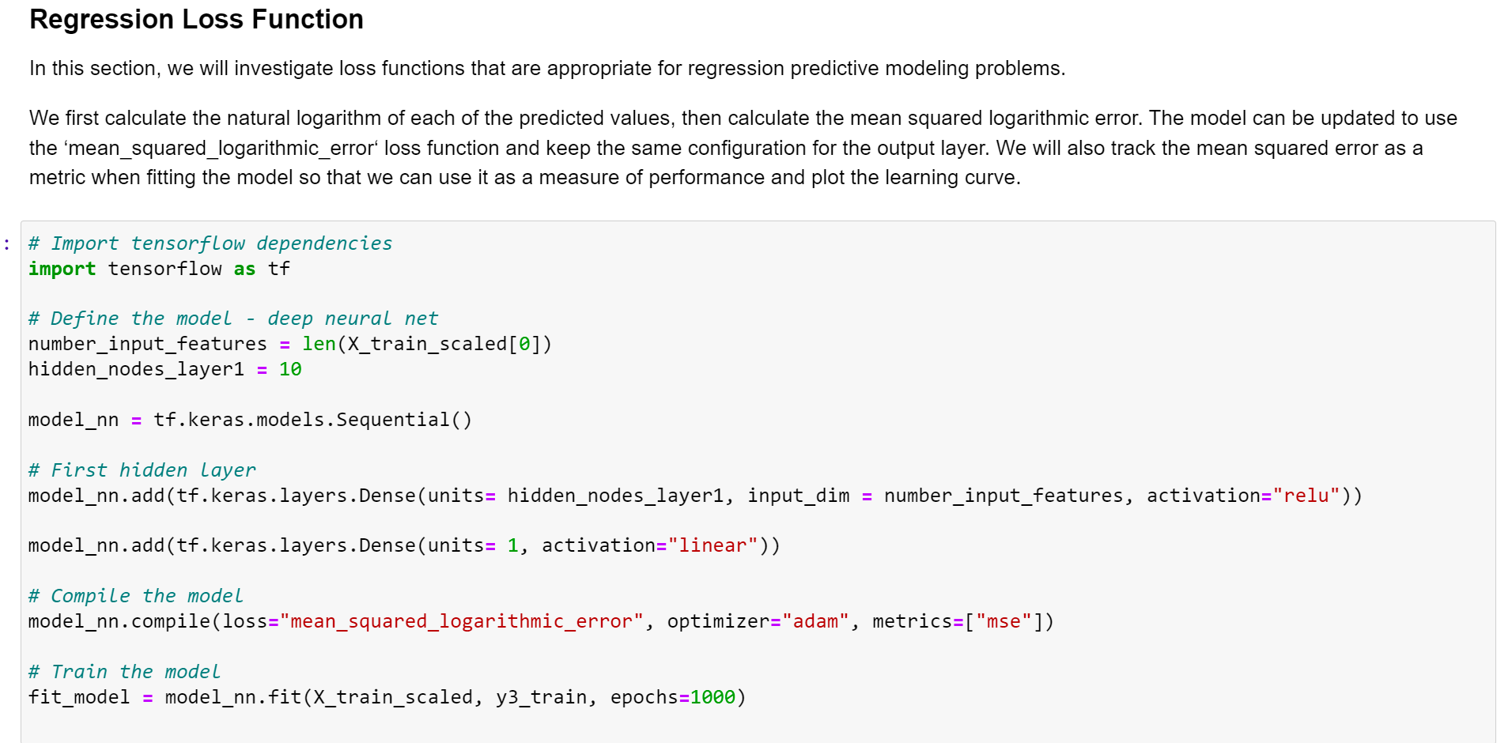
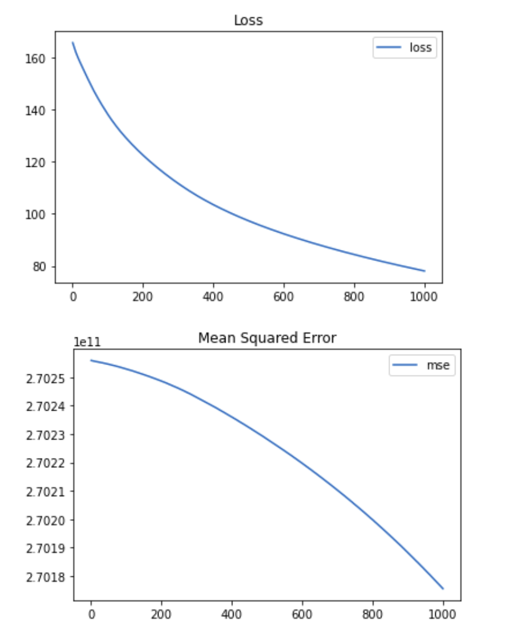
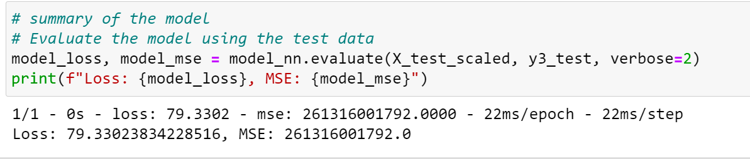
ML: Neural Network Model
Notes:
We are using the linear function in the output to determine MSE (Mean squared error) instead of Accuracy for the Evaluation metrics. We started with lower Epochs number (~50) . In order to improve the model design and parameters, we increased the number of epochs up to 1000. Seems like the model tend to decrease in loss values when we increase Epochs number as you can see in the plot on the right side. For this study, we stop at 1000 epochs. NN model still doesn’t meet the performance expectations. It can be because our given datasets are Inadaquate or Inappropriate for this model design or insufficient training data. (Having more datasets would be beneficial).

Slide 22
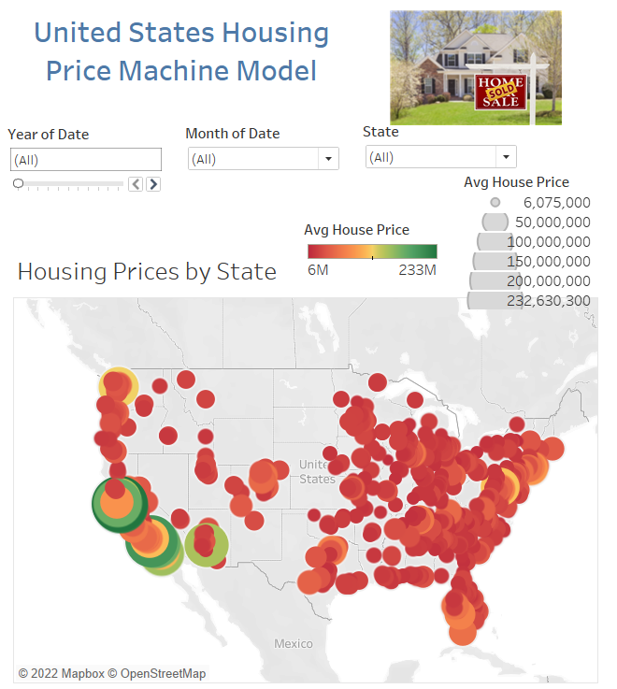
Data Visualization: GUI & Tableau
Outlier Project | tkinter GUI | Tableau Public
Notes:
I will be highlighting some of our data visualizations we created

Slide 23
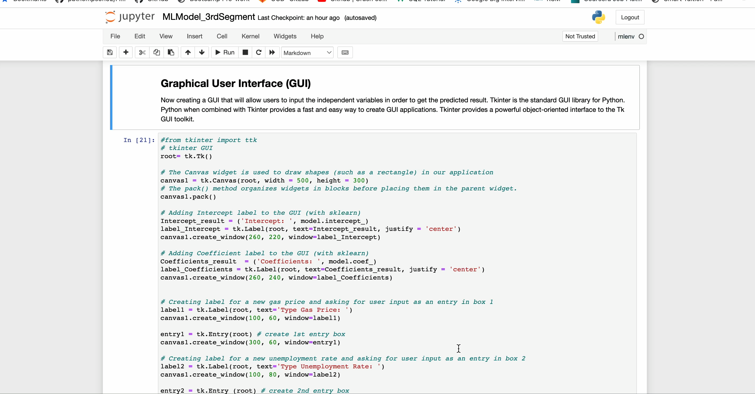
Multiple Linear Regression Model: Graphic User Interface
Notes:
This is a visualization of the multiple linear regression model using the GUI tkinter python library.
When we run this code, it brings us to a pop up window asking for user input values. We will input the exact same values as we did before for predictions. Upon entering all the numbers, we click the ‘Predict Housing Price Button’ and we get a prediction highlighted in orange. This number $750,321 is the same what we got before with the sklearn model.

Slide 24
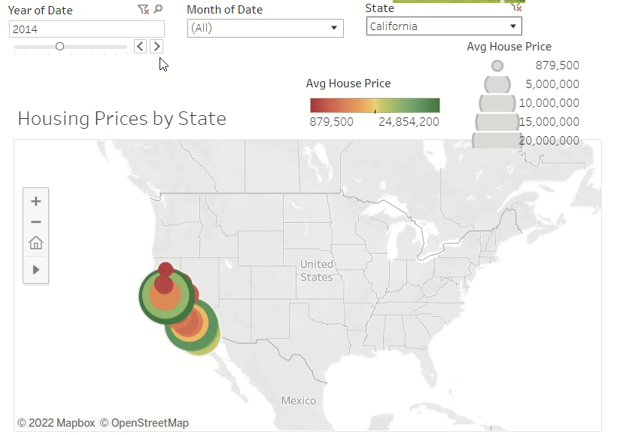
Notes:
- We also created a number of visuals in tableau to demonstrate the change in housing prices over time across the United States
Here you can see a bubble map that shows housing price in the United States with option to filter by year, focus in on a specific region (such as Califiornia) or show all states across the country

Slide 25
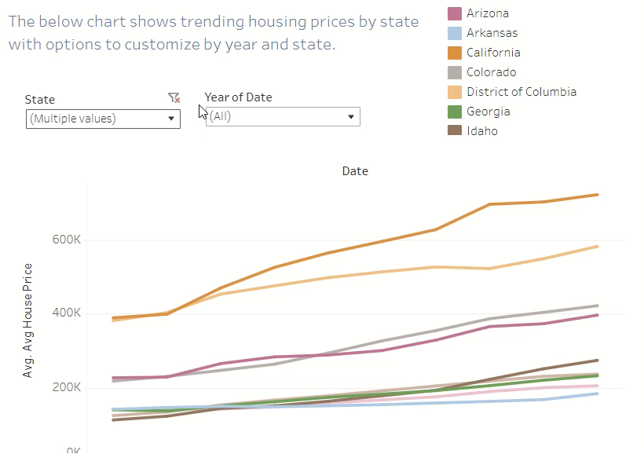
Notes:
We also created a visual that shows trending of housing prices over time with options to compare across different states
As you can see, you have the option to add or remove states to do more in depth analysis of limit to a specific date range

Slide 26
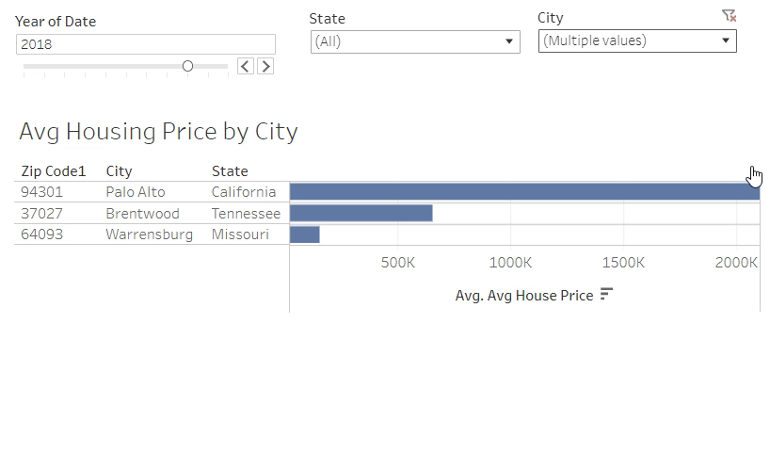
Notes:
Lastly we created a double click that shows housing prices at a more granular level by city
Again you have the option to see all the cities in our data set or filter to compare just a few

Slide 27
Recommendations and Lessons Learned
Recommendations
Research more region-specific data points
Lessons Learned
Add additional variables
Identify more region-specific variables
Identify more comprehensive data source to eliminate null values
Notes:
Overall our biggest recommendation and lesson learned from this project would be to include more region-specific data
A lot of the data we had was at a regional level or took averages across multiple states and we realized the accuracy could be improved if we have more region specific data
We would also look for more comprehensive data set as we did have to eliminate a lot of years due to null values

Slide 28
Questions?

Slide 29
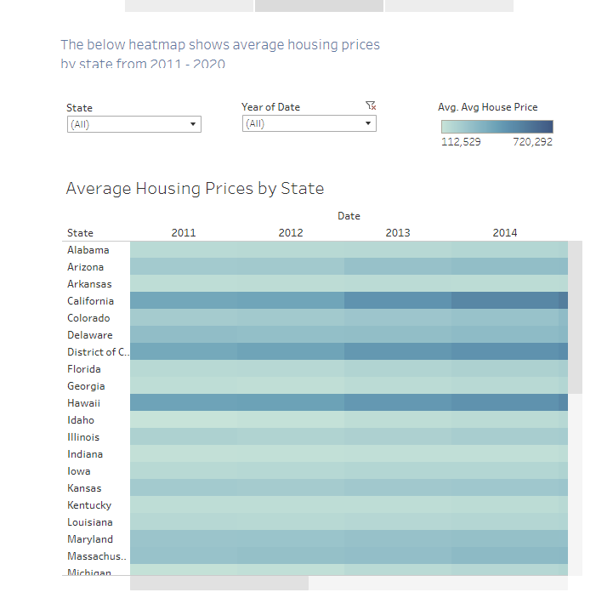

Slide 30
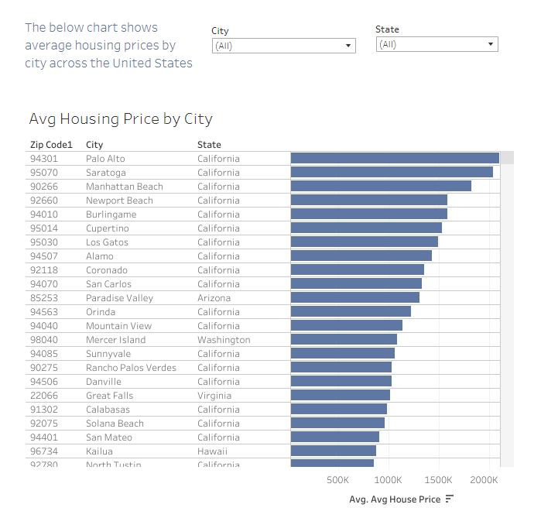

Slide 31
Appendix

Slide 32
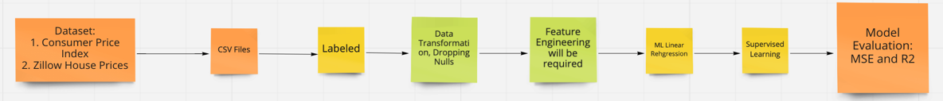
Machine Learning Flow Chart
Datasets (CSVs, Labeled):
Consumer Price Index
Housing Prices
Mortgage Rates
Gas Prices
Unemployment Rates
Data Transformation:
Dropping null values
Filtering dates
Dropped unnecessary columns
Transposed data
Set date as index, region id as column headers
Converted date to uniform date-time
Assigned zips and coordinates to locations
Machine Learning Model:
Multi-Linear Model
Supervised Learning
Model Evaluation:
MSE
R2

Slide 33
Icons Icons should be primarily used as a visual aid, as a way to break up large amounts of text and content, or as a visual cue of the content that follows. Get the full set of icons for presentations
INDUSTRY SECTORS
Aeronautics | Agriculture | Architecture | Automotive | Construction | Education and research | Energy | Financial services | Healthcare | Engineering and manufacturing | Professional services, media | Sports
Government | Retail | Technology | Media and broadcasting | Travel and transportation | Education | Law | Science | - | - | - | -
MAPS / LOCATION
Globe, global, earth | Globe, global, earth | Navigation, GPS, POI, location, map | Map, location, GPS, directions, navigation | Navigation, GPS, POI, location, map | Map, location, route, quest, destination, journey | Download map, receive location | - | - | - | - | -
MONEY / FINANACE / RETAIL / CONSUMER
Shopping cart, store | Store, bag, shop | Money, dollar sign, cash, revenue, currency | Revenue, financial report, funds | Money, currency, coins | Bank, piggybank | Compare, balance, finance, justice | Credit card, payment, charge, debit card | Mobile payment, digital payment, e-commerce | Barcode scanner | Tag, sale, shopping | Bank

Slide 34
Get the full set of icons for presentations
OBJECTS / TOOLS
Alarm clock | Hourglass, timer | Clock | Flashlight | Funnel | Calculator | Binoculars | Scissors | Camera | Battery, power, charge | Magnifying glass | Tools, screwdriver, wrench
Paperclip | Pushpin, thumbtack | Key | Lock | Safe | Piggybank | Bag | Ballot box, drop box | Box, archive, storage | Present, giftbox | Box, package, shipping | Briefcase, business, work, job
Books, reading | Book, dictionary, novel | Notebook, journal | Pencil | Paintbrush | Paint palette, color | 3D, hologram | Trophy, award | Ribbon, award, reward, accomplishment | Ribbon, award, reward, accomplishment | Flag, finish line | Flags, finish line, win, race
Open door, entryway, opportunity | Clipboard | Megaphone, speaker, speech, announcement | Microphone | CD, music album | Headphones | Headset | Eye glasses | Bike, bicycle | Umbrella, bumbershoot | Balloon, party, celebration | Rocking chair
Remote control | Robotic, manufacturing, mechanical, automation | Forklift | Gears | Traffic cone, construction | Flask, chemistry, science, beaker | Maze, puzzle | Target, bullseye, aim, arrow, dartboard, darts, archery | Games, strategy, chess, poker | Musical instrument, drums | Pizza, food | Lightbulb

